Slide 1

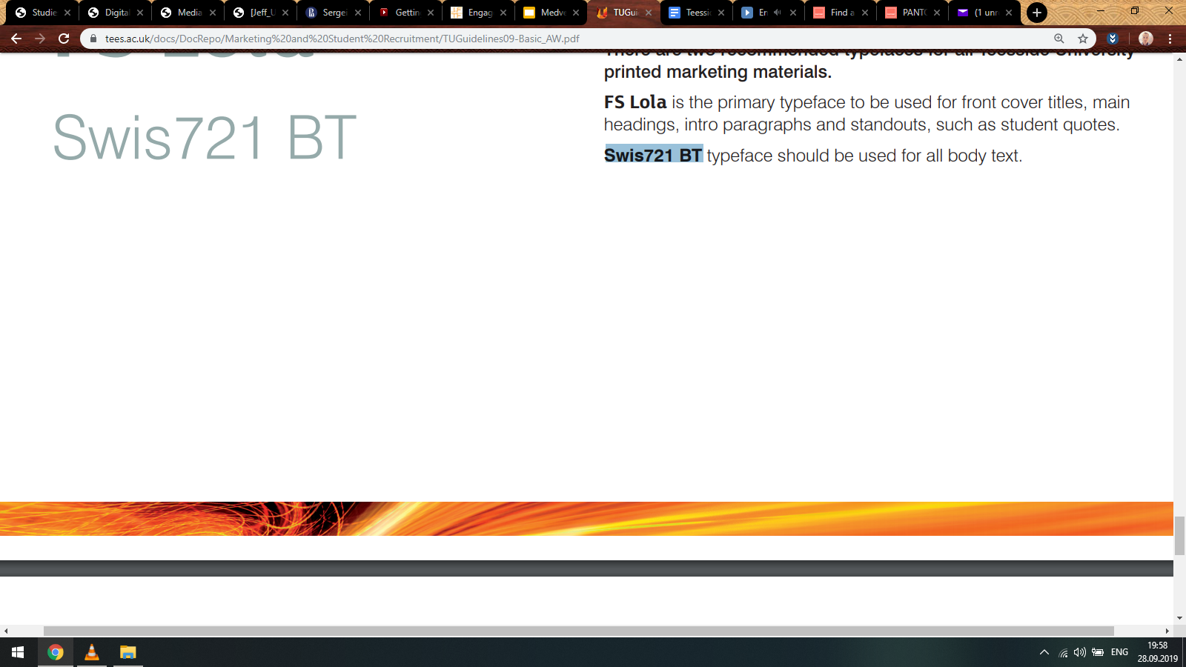
Transmedia Production
Course Overview
Sergei Medvedev
tudublin.ie

Slide 2

Complex Projects = Complex Audiences
Participation Funnel
Audience Classifications
Microtargeting and Machine Learning
1
tudublin.ie

Slide 3

Participation Funnel. Or a Spiral?
DISCOVERY
Attract casual audience as large as possible
Sales funnels look more like spirals now - with social media and machine learning algorithms (like Twitter trends) changing the rules
ENGAGEMENT
Work to convert casuals to hardcore
ACTIVATION
Sell paid content or ‘tokens’ (extractability)
ADVOCACY
Work with fans to spread word and expand audience
Medvedev, S. (2015) ‘Il branding transmediale nella moda: il caso Burberry’ [Transmedia Branding in Fashion: The Case of Burberry]. ZoneModa Journal, 5, 74-81.
2
tudublin.ie

Slide 4
Free labour?
“The provision of ‘free labor’ (...) is a fundamental moment in the creation of value in the digital economies” (Terranova, 2000: 36).
Prosumer by Alvin Toffler (The Third Wave, 1980)
Produsage participant by Axel Bruns (Blogs, Wikipedia, Second Life and Beyond: From Production to Produsage, 2008)
As transmedia producers, we cannot afford thinking of the audience as free labour,
because they do long to profit from interacting with the project
3
tudublin.ie

Slide 5
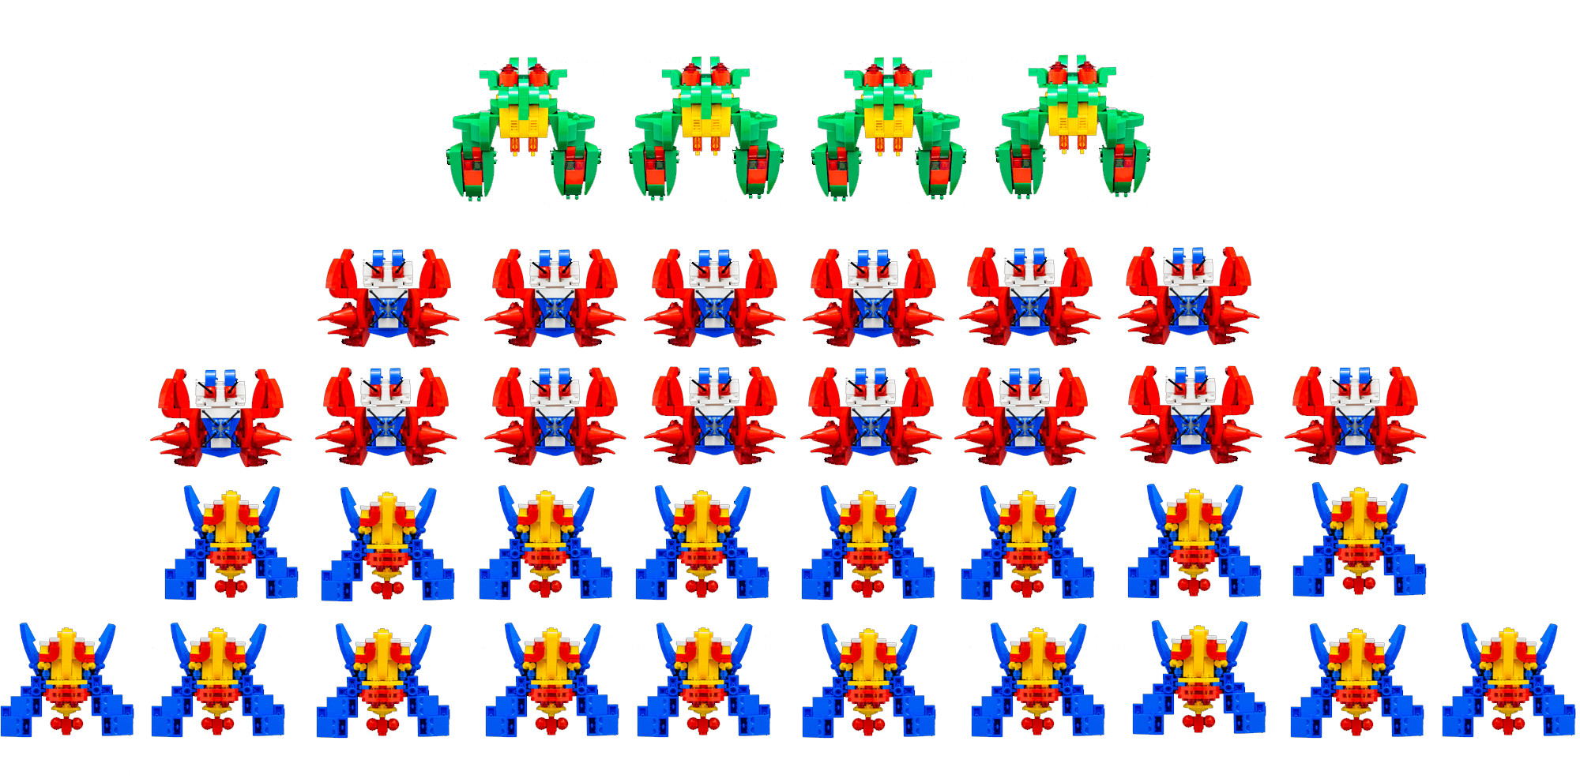
Participation
Hierarchies
People satisfy needs with media consumption
(Katz, Blumler and Gurevitch, Uses and Gratifications Research, 1973)
‘Produsage participants gain status within the community on the basis of their contributions’
(Bruns, Prosumption, Produsage, 2016: 3)
Participatory culture concerns to ‘informal mentorship whereby what is known by the experienced is passed along to novices’
(Jenkins et al., Confronting the Challenges of Participatory Culture, 2005: 5-6)
Media usage is about consuming what is valuable, but produsage is about becoming valuable by creating something that is valued by others
Medvedev, S. and Pronkina, E. (2019) ‘Harry Potter Fandom and Narratives of Inequality in the United States Presidential Election of 2016’. In Bell C (Ed) Transmedia Harry Potter, McFarland & Company, Jefferson, NC.
4
tudublin.ie

Slide 6

Distribution
Supporters = n
Base = n/10
Casual volunteers = n/10²
Full-time volunteers = n/10³
Gambarato, R. and Medvedev, S. (forthcoming) ICT and Transmedia Storytelling for Democratic Development in the Russian Political Landscape in Examining the Roles of IT And Social Media in Democratic Development and Social Change. IGI Global, Hershey, PA.
The question:
What is the optimal trade-off between investing in the casual majority and dedicated minority?
Number of participants
Intensity of engagement
5
tudublin.ie

Slide 7




Classifications: Psychographics
ACTING
KILLERS
ACHIEVERS
Competitions
KILLERS
ACHIEVERS
SOCIALIZERS
EXPLORERS
ARG
Online games
Puzzles
ARG
Mysteries
PLAYER
WORLD
Content to be consumed
Stories
Cosplay
Commenting
Videos
Forums
SOCIALIZERS
EXPLORERS
Pratten, R. (2011) Getting Started In Transmedia Storytelling: A Practical Guide For Beginners. Available at http://videoturundus.ee/transmedia.pdf
INTERACTING
6
tudublin.ie

Slide 8

Classifications: Modes of Consumption
real-time viewers
who must find suspense and satisfaction in each single episode
VS
reflective long-term audience who look for coherent patterns in the story as a whole
VS
navigational viewers who takes pleasure in following the connections between different parts of the story
(Murray, Hamlet on the Holodeck: The Future of Narrative in Cyberspace, 1997: 236-237)
7
tudublin.ie

Slide 9
Classifications: Demographics
Millennials | Single |  | Women
 |  |  | Men
Gen Z | Married
 |  |  | Non Binary
OK. We’ve created opportunities for participation and catered to the needs of different users.
How will they know?
8
tudublin.ie

Slide 10
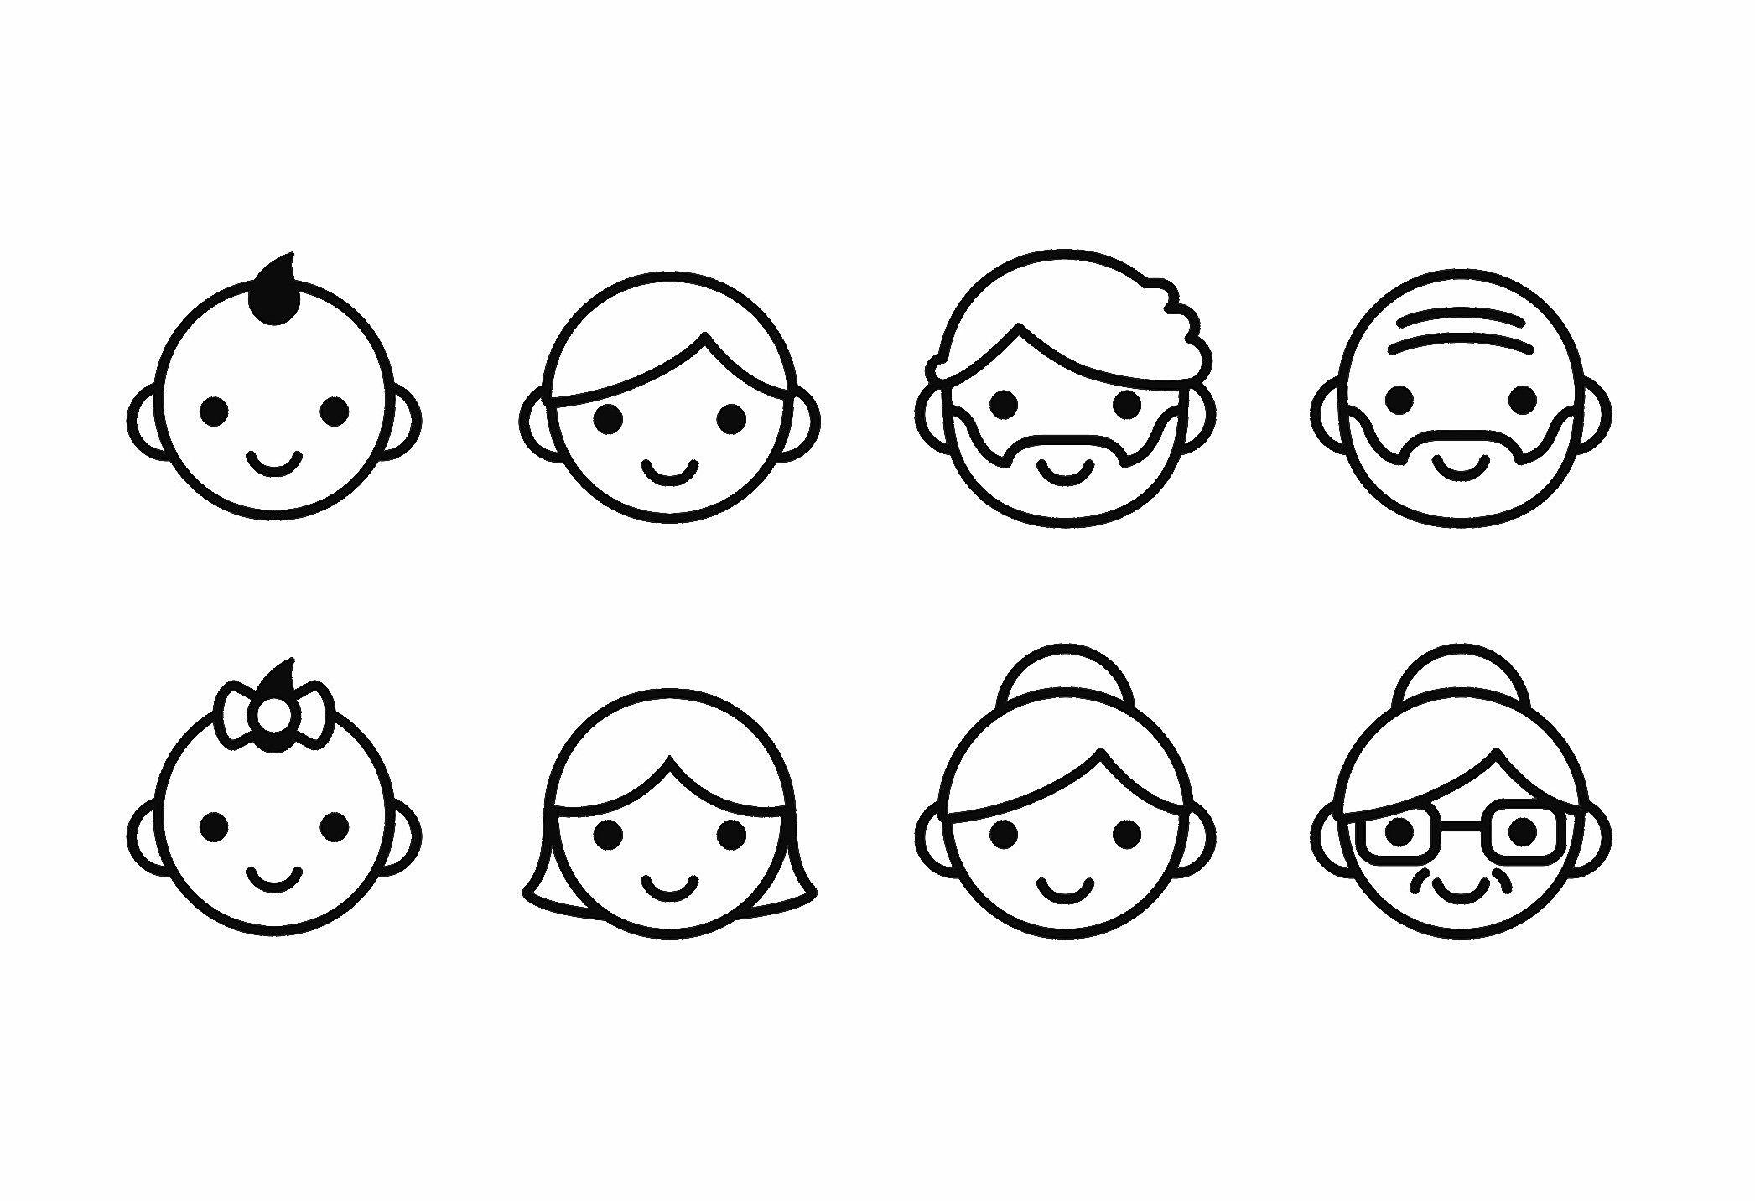
ML for Personalised Experience
MICROTARGETING
RECOMMENDER SYSTEMS
With collaborative filtering, not only fans but virtually every user becomes an ambassador of what they watch, play or like.
Result: more personalised communication, customisation, and cost-effectiveness
Facebook Ads
Google Search Network
Google Display Network
Youtube TrueView Ads
Data collection (FB Lead Ads, quizzes, surveys, forms, test ads on social media)
Dimensionality reduction
Making recommendations
Returning results back to the system
Facebook Lead Ad
Remarketing
Medvedev, S. (2019) Movie Collaborative
Recommender System. Available at: https://github.com/mediamedvedev/Data_portfolio/blob/master/Recommender System with Spark and IBM Watson Studio.ipynb
9
tudublin.ie

Slide 11

THANK YOU
tudublin.ie

